Slide 1
Data Analytics – Lesson 16 Decision Trees
Jeffrey Strickland, Ph.D., CMSP, ASEP
CEO Humalytica Analytics

Slide 2
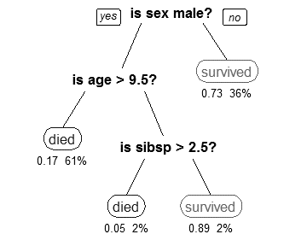
Decision Tree Learning
Decision tree learning is a method commonly used in data mining (Rokach & Maimon, 2008).
The goal is to create a model that predicts the value of a target variable based on several input variables.
An example is shown on the right.
Each interior node corresponds to one of the input variables; there are edges to children for each of the possible values of that input variable.
Each leaf represents a value of the target variable given the values of the input variables represented by the path from the root to the leaf.

Slide 3
Decision Tree Example
Let’s say we have a sample of 30 students with three variables Gender (Boy/ Girl), Class( IX/ X) and Height (5 to 6 ft). 15 out of these 30 play cricket in leisure time. Now, I want to create a model to predict who will play cricket during leisure period? In this problem, we need to segregate students who play cricket in their leisure time based on highly significant input variable among all three.

Slide 4
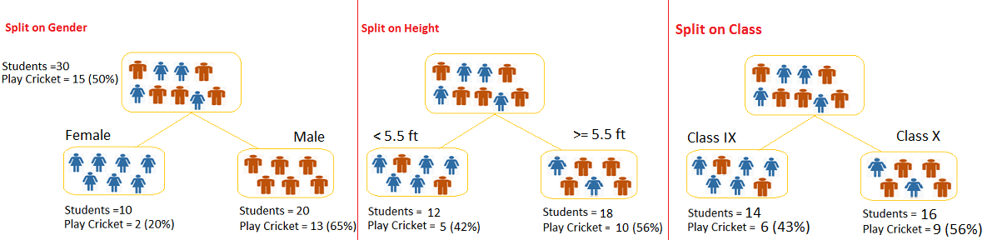
Decision Tree Example
This is where decision tree helps, it will segregate the students based on all values of three variable and identify the variable, which creates the best homogeneous sets of students (which are heterogeneous to each other).
In the snapshot below, you can see that variable Gender is able to identify best homogeneous sets compared to the other two variables.

Slide 5
Types of Decision Trees
Classification tree analysis is when the predicted outcome is the class to which the data belongs.
species of iris
Regression tree analysis is when the predicted outcome can be considered a real number
price of a house
patient’s length of stay in a hospital

Slide 6
Ensembles
Some techniques, often called ensemble methods, construct more than one decision tree:
Bagging decision trees, an early ensemble method, builds multiple decision trees by repeatedly resampling training data with replacement, and voting the trees for a consensus prediction.
A Random Forest classifier uses a number of decision trees in order to improve the classification rate.
Boosted Trees can be used for regression-type and classification-type problems.[
Rotation forest - in which every decision tree is trained by first applying principal component analysis (PCA) on a random subset of the input features.

Slide 7
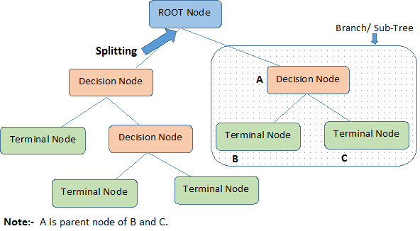
Important Terminology for Decision Trees

Slide 8
Important Terminology for Decision Trees
Root Node: It represents entire population or sample and this further gets divided into two or more homogeneous sets.
Splitting: It is a process of dividing a node into two or more sub-nodes.
Decision Node: When a sub-node splits into further sub-nodes, then it is called decision node.
Leaf/ Terminal Node: Nodes do not split is called Leaf or Terminal node.
Pruning: When we remove sub-nodes of a decision node, this process is called pruning. You can say opposite process of splitting.
Branch / Sub-Tree: A sub section of entire tree is called branch or sub-tree.
Parent and Child Node: A node, which is divided into sub-nodes is called parent node of sub-nodes where as sub-nodes are the child of parent node.

Slide 9
The Algorithms
Decision tree learning is the construction of a decision tree from class-labeled training tuples.
A decision tree is a flow-chart-like structure, where each internal (non-leaf) node denotes a test on an attribute, each branch represents the outcome of a test, and each leaf (or terminal) node holds a class label.
The topmost node in a tree is the root node.
There are many specific decision-tree algorithms. Notable ones include:
ID3 (Iterative Dichotomiser 3)
C4.5 (successor of ID3)
CART (Classification And Regression Tree)
CHAID (CHi-squared Automatic Interaction Detector). Performs multi-level splits when computing classification trees.[11]
MARS: extends decision trees to handle numerical data better.
Conditional Inference Trees. Statistics-based approach that uses non-parametric tests as splitting criteria, corrected for multiple testing to avoid overfitting.

Slide 10
Advantages
Simple to understand and interpret. People are able to understand decision tree models after a brief explanation.
Requires little data preparation. Other techniques often require data normalisation, dummy variables need to be created and blank values to be removed.
Able to handle both numerical and categorical data. Other techniques are usually specialised in analysing datasets that have only one type of variable.
Uses a white box model. If a given situation is observable in a model the explanation for the condition is easily explained by boolean logic.
Possible to validate a model using statistical tests. That makes it possible to account for the reliability of the model.
Robust. Performs well even if its assumptions are somewhat violated by the true model from which the data were generated.
Performs well with large datasets. Large amounts of data can be analysed using standard computing resources in reasonable time.

Slide 11
Limitations
NP-complete: practical decision-tree learning algorithms are based on heuristics such as the greedy algorithm where locally-optimal decisions are made at each node. Such algorithms cannot guarantee to return the globally-optimal decision tree.
Decision-tree learners can create over-complex trees that do not generalize well from the training data. (This is known as overfitting) Mechanisms such as pruning are necessary to avoid this problem
There are concepts that are hard to learn because decision trees do not express them easily, such as XOR, parity or multiplexer problems. In such cases, the decision tree becomes prohibitively large.
For data including categorical variables with different numbers of levels, information gain in decision trees is biased in favor of those attributes with more levels.

Slide 12
Metrics
Gini impurity
Used by the CART (classification and regression tree) algorithm, Gini impurity is a measure of how often a randomly chosen element from the set would be incorrectly labeled if it was randomly labeled according to the distribution of labels in the subset.
Information gain
Used by the ID3, C4.5 and C5.0 tree-generation algorithms. Information gain is based on the concept of entropy from information theory.
Variance reduction
Introduced in CART, variance reduction is often employed in cases where the target variable is continuous (regression tree), meaning that use of many other metrics would first require discretization before being applied.

Slide 13

Gini
Gini index says, if we select two items from a population at random then they must be of same class and probability for this is 1 if population is pure.
It works with categorical target variable “Success” or “Failure”.
It performs only Binary splits
Higher the value of Gini higher the homogeneity.
CART (Classification and Regression Tree) uses Gini method to create binary splits.
Steps to Calculate Gini for a split
Calculate Gini for sub-nodes, using formula sum of square of probability for success and failure $\left(p^{2}+q^{2}\right)$.
Calculate Gini for split using weighted Gini score of each node of that split

Slide 14
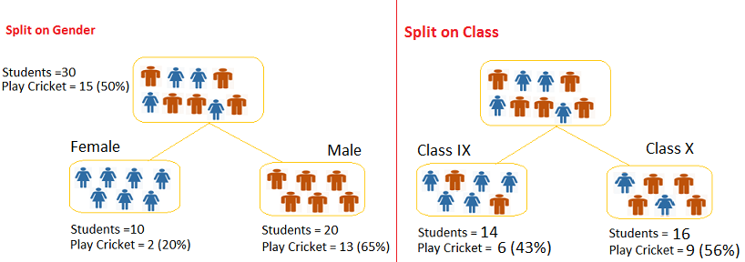
Gini Example
Example: – Referring to example used above, where we want to segregate the students based on target variable ( playing cricket or not ). In the snapshot below, we split the population using two input variables Gender and Class. Now, I want to identify which split is producing more homogeneous sub-nodes using Gini index.

Slide 15
Gini Example
Split on Gender:
Calculate, Gini for sub-node Female = (0.2)*(0.2)+(0.8)*(0.8)=0.68
Gini for sub-node Male = (0.65)*(0.65)+(0.35)*(0.35)=0.55
Calculate weighted Gini for Split Gender = (10/30)*0.68+(20/30)*0.55 = 0.59
Similar for Split on Class:
Gini for sub-node Class IX = (0.43)*(0.43)+(0.57)*(0.57)=0.51
Gini for sub-node Class X = (0.56)*(0.56)+(0.44)*(0.44)=0.51
Calculate weighted Gini for Split Class = (14/30)*0.51+(16/30)*0.51 = 0.51
Above, you can see that Gini score for Split on Gender is higher than Split on Class, hence, the node split will take place on Gender.

Slide 16
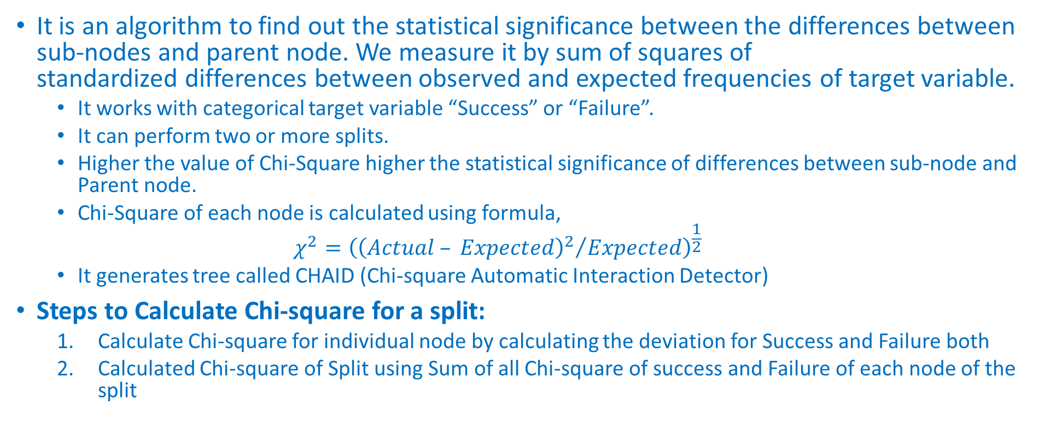
Chi-Square
It is an algorithm to find out the statistical significance between the differences between sub-nodes and parent node. We measure it by sum of squares of standardized differences between observed and expected frequencies of target variable.
It works with categorical target variable “Success” or “Failure”.
It can perform two or more splits.
Higher the value of Chi-Square higher the statistical significance of differences between sub-node and Parent node.
Chi-Square of each node is calculated using formula,
$$χ^{2}={\left({{\left(Actual – Expected\right)}^{2}}/{Expected}\right)}^{\frac{1}{2}}$$
It generates tree called CHAID (Chi-square Automatic Interaction Detector)
Steps to Calculate Chi-square for a split:
Calculate Chi-square for individual node by calculating the deviation for Success and Failure both
Calculated Chi-square of Split using Sum of all Chi-square of success and Failure of each node of the split

Slide 17
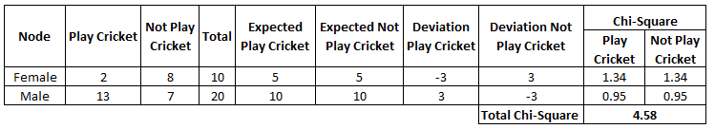
Chi-Square Example
Split on Gender:
First we are populating for node Female, Populate the actual value for “Play Cricket” and “Not Play Cricket”, here these are 2 and 8 respectively.
Calculate expected value for “Play Cricket” and “Not Play Cricket”, here it would be 5 for both because parent node has probability of 50% and we have applied same probability on Female count(10).
Calculate deviations by using formula, Actual – Expected. It is for “Play Cricket” (2 – 5 = -3) and for “Not play cricket” ( 8 – 5 = 3).
Calculate Chi-square of node for “Play Cricket” and “Not Play Cricket” using formula with formula,= ((Actual – Expected)^2 / Expected)^1/2. You can refer below table for calculation.
Follow similar steps for calculating Chi-square value for Male node.
Now add all Chi-square values to calculate Chi-square for split Gender.

Slide 18
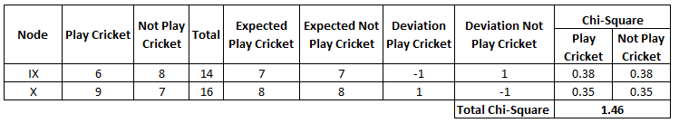
Chi-Square Example
Split on Class:
Perform similar steps of calculation for split on Class and you will come up with below table.

Slide 19
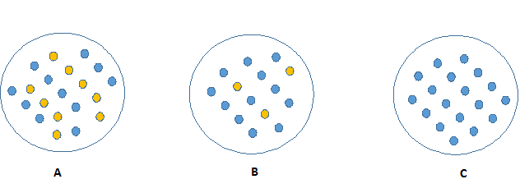
Information Gain
Look at the image below and think which node can be described easily. I am sure, your answer is C because it requires less information as all values are similar. On the other hand, B requires more information to describe it and A requires the maximum information. In other words, we can say that C is a Pure node, B is less Impure and A is more impure.

Slide 20

Information Gain
Now, we can build a conclusion that less impure node requires less information to describe it.
And, more impure node requires more information. Information theory is a measure to define this degree of disorganization in a system known as Entropy.
If the sample is completely homogeneous, then the entropy is zero and if the sample is an equally divided (50% – 50%), it has entropy of one.
Entropy can be calculated using formula:
$$Entropy=−p\log_{2}{p}−1\log_{2}{q}$$
Here p and q is probability of success and failure respectively in that node. Entropy is also used with categorical target variable.
It chooses the split which has lowest entropy compared to parent node and other splits.
The lesser the entropy, the better it is.

Slide 21
Information Gain
Steps to calculate entropy for a split:
Calculate entropy of parent node
Calculate entropy of each individual node of split and calculate weighted average of all sub-nodes available in split.

Slide 22
Information Gain
Example: Let’s use this method to identify best split for student example.
Entropy for parent node = -(15/30) log2 (15/30) – (15/30) log2 (15/30) = 1. Here 1 shows that it is a impure node.
Entropy for Female node = -(2/10) log2 (2/10) – (8/10) log2 (8/10) = 0.72 and for male node, -(13/20) log2 (13/20) – (7/20) log2 (7/20) = 0.93
Entropy for split Gender = Weighted entropy of sub-nodes = (10/30)*0.72 + (20/30)*0.93 = 0.86
Entropy for Class IX node, -(6/14) log2 (6/14) – (8/14) log2 (8/14) = 0.99 and for Class X node, -(9/16) log2 (9/16) – (7/16) log2 (7/16) = 0.99
Entropy for split Class = (14/30)*0.99 + (16/30)*0.99 = 0.99
We can see that entropy for Split on Gender is the lowest among all, so the tree will split on Gender. We can derive information gain from entropy as 1- Entropy.

Slide 23
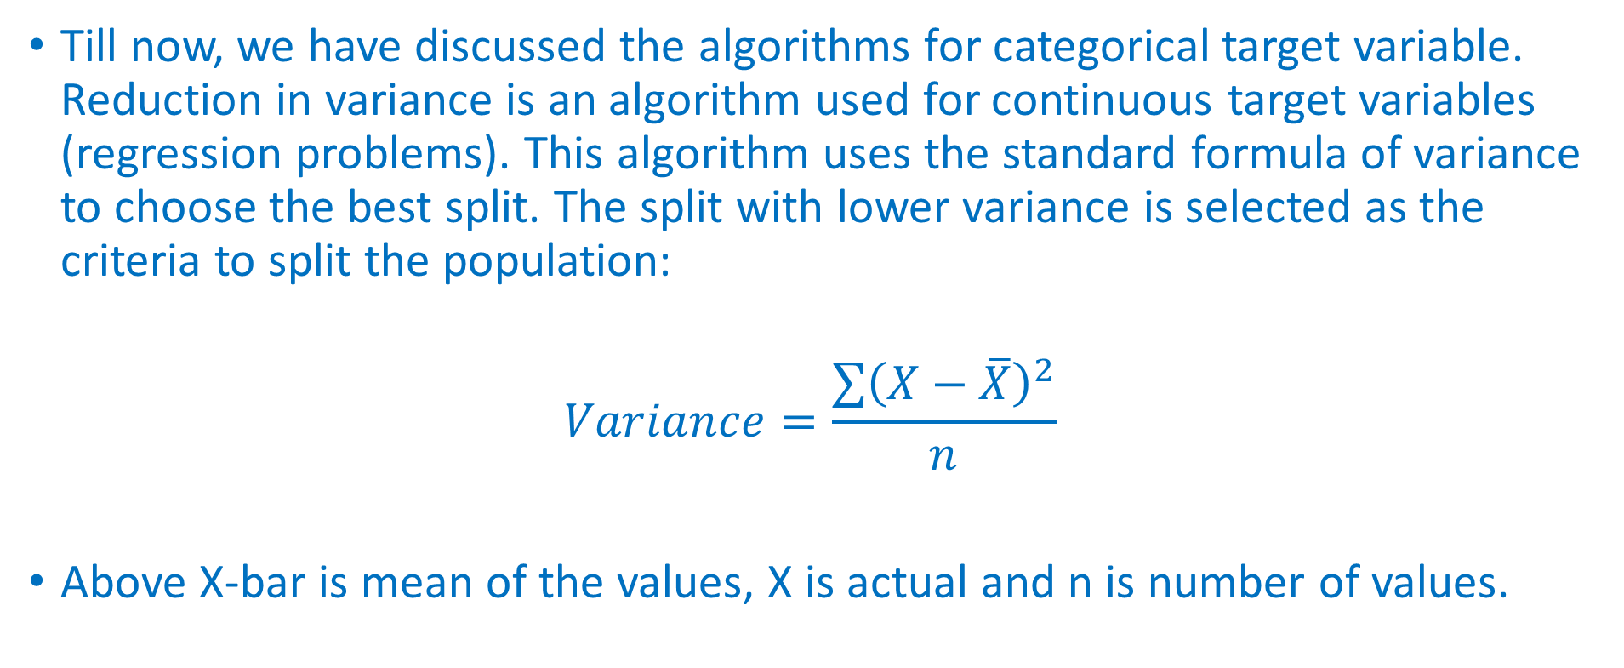
Reduction in Variance
Till now, we have discussed the algorithms for categorical target variable. Reduction in variance is an algorithm used for continuous target variables (regression problems). This algorithm uses the standard formula of variance to choose the best split. The split with lower variance is selected as the criteria to split the population:
$$Variance=\frac{\sum{{\left(X−\overline{X}\right)}^{2}}}{n}$$
Above X-bar is mean of the values, X is actual and n is number of values.

Slide 24
Reduction in Variance
Steps to calculate Variance:
Calculate variance for each node.
Calculate variance for each split as weighted average of each node variance.

Slide 25
Reduction in Variance
Example:- Let’s assign numerical value 1 for play cricket and 0 for not playing cricket. Now follow the steps to identify the right split:
Variance for Root node, here mean value is (15*1 + 15*0)/30 = 0.5 and we have 15 one and 15 zero. Now variance would be ((1-0.5)^2+(1-0.5)^2+….15 times+(0-0.5)^2+(0-0.5)^2+…15 times) / 30, this can be written as (15*(1-0.5)^2+15*(0-0.5)^2) / 30 = 0.25
Mean of Female node = (2*1+8*0)/10=0.2 and Variance = (2*(1-0.2)^2+8*(0-0.2)^2) / 10 = 0.16
Mean of Male Node = (13*1+7*0)/20=0.65 and Variance = (13*(1-0.65)^2+7*(0-0.65)^2) / 20 = 0.23
Variance for Split Gender = Weighted Variance of Sub-nodes = (10/30)*0.16 + (20/30) *0.23 = 0.21
Mean of Class IX node = (6*1+8*0)/14=0.43 and Variance = (6*(1-0.43)^2+8*(0-0.43)^2) / 14= 0.24
Mean of Class X node = (9*1+7*0)/16=0.56 and Variance = (9*(1-0.56)^2+7*(0-0.56)^2) / 16 = 0.25
Variance for Split Class = (14/30)*0.24 + (16/30) *0.25 = 0.25
Above, you can see that Gender split has lower variance compare to parent node, so the split would take place on Gender variable.

Slide 26
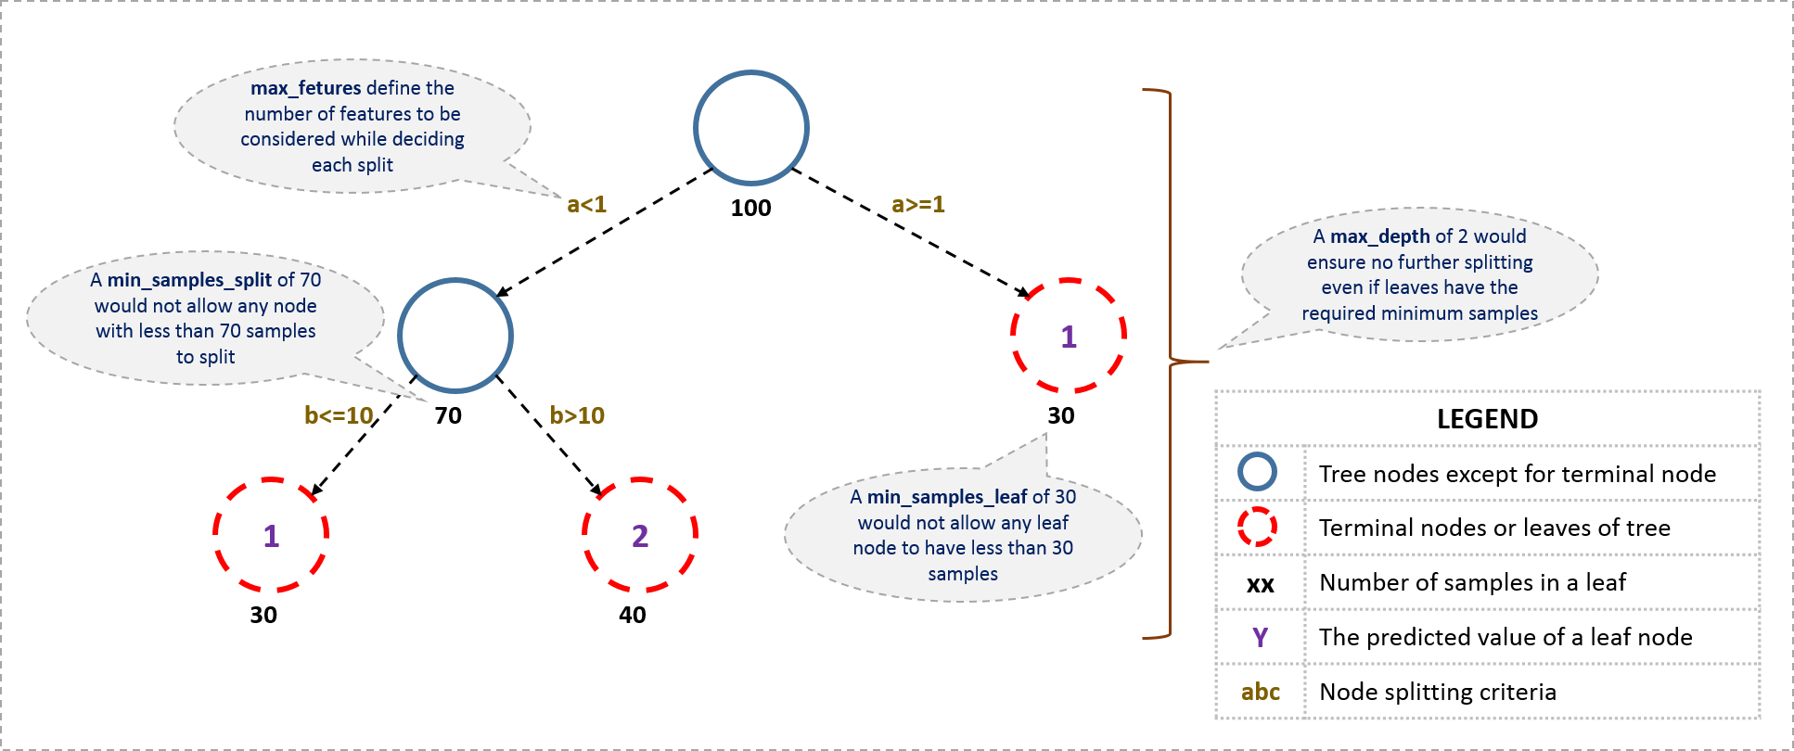
Setting Constraints on Tree Size
1
1
2
Y

Slide 27
Parameters are available in R & Python.
Minimum samples for a node split
Defines the minimum number of samples (or observations) which are required in a node to be considered for splitting.
Used to control over-fitting. Higher values prevent a model from learning relations which might be highly specific to the particular sample selected for a tree.
Too high values can lead to under-fitting hence, it should be tuned using CV.
Minimum samples for a terminal node (leaf)
Defines the minimum samples (or observations) required in a terminal node or leaf.
Used to control over-fitting similar to min_samples_split.
Generally lower values should be chosen for imbalanced class problems because the regions in which the minority class will be in majority will be very small.

Slide 28
Parameters are available in R & Python.
Maximum depth of tree (vertical depth)
The maximum depth of a tree.
Used to control over-fitting as higher depth will allow model to learn relations very specific to a particular sample.
Should be tuned using CV.
Maximum number of terminal nodes
The maximum number of terminal nodes or leaves in a tree.
Can be defined in place of max_depth. Since binary trees are created, a depth of ‘n’ would produce a maximum of 2^n leaves.

Slide 29
Parameters are available in R & Python.
Maximum features to consider for split
The number of features to consider while searching for a best split. These will be randomly selected.
As a thumb-rule, square root of the total number of features works great but we should check upto 30-40% of the total number of features.
Higher values can lead to over-fitting but depends on case to case.

Slide 30
ID3 Algorithm
The ID3 algorithm begins with the original set S as the root node.
On each iteration of the algorithm, it iterates through every unused attribute of the set S and calculates the entropy H(S) (or information gain IG(S) of that attribute.
It then selects the attribute which has the smallest entropy (or largest information gain) value.
The set S is then split by the selected attribute (e.g. age is less than 50, age is between 50 and 100, age is greater than 100) to produce subsets of the data. The algorithm continues to recurse on each subset, considering only attributes never selected before.
Recursion on a subset may stop in one of these cases:
every element in the subset belongs to the same class (+ or -), then the node is turned into a leaf and labelled with the class of the examples
there are no more attributes to be selected, but the examples still do not belong to the same class (some are + and some are -), then the node is turned into a leaf and labelled with the most common class of the examples in the subset
there are no examples in the subset, this happens when no example in the parent set was found to be matching a specific value of the selected attribute, for example if there was no example with age >= 100. Then a leaf is created, and labelled with the most common class of the examples in the parent set.

Slide 31
ID3 Summary
Calculate the entropy of every attribute using the data set S
Split the set S into subsets using the attribute for which entropy is minimum (or, equivalently, information gain is maximum)
Make a decision tree node containing that attribute
Recurse on subsets using remaining attributes.

Slide 32
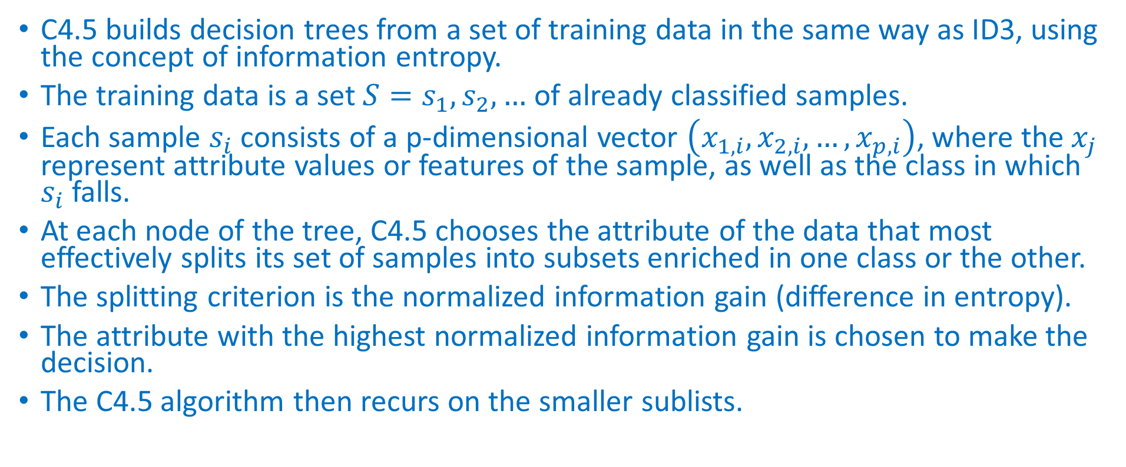
C4.5 Algorithm
C4.5 builds decision trees from a set of training data in the same way as ID3, using the concept of information entropy.
The training data is a set $S=s_{1}, s_{2}, …$ of already classified samples.
Each sample $s_{i}$ consists of a p-dimensional vector $\left(x_{1,i},x_{2,i}, …,x_{p,i}\right)$, where the $x_{j}$ represent attribute values or features of the sample, as well as the class in which $s_{i}$ falls.
At each node of the tree, C4.5 chooses the attribute of the data that most effectively splits its set of samples into subsets enriched in one class or the other.
The splitting criterion is the normalized information gain (difference in entropy).
The attribute with the highest normalized information gain is chosen to make the decision.
The C4.5 algorithm then recurs on the smaller sublists.

Slide 33
C4.5 Base Cases
All the samples in the list belong to the same class. When this happens, it simply creates a leaf node for the decision tree saying to choose that class.
None of the features provide any information gain. In this case, C4.5 creates a decision node higher up the tree using the expected value of the class.
Instance of previously-unseen class encountered. Again, C4.5 creates a decision node higher up the tree using the expected value.

Slide 34
C4.5 Improvements to ID3
Handling both continuous and discrete attributes - In order to handle continuous attributes, C4.5 creates a threshold and then splits the list into those whose attribute value is above the threshold and those that are less than or equal to it.
Handling training data with missing attribute values - C4.5 allows attribute values to be marked as ? for missing. Missing attribute values are simply not used in gain and entropy calculations.
Handling attributes with differing costs.
Pruning trees after creation - C4.5 goes back through the tree once it's been created and attempts to remove branches that do not help by replacing them with leaf nodes.

Slide 35
CHi-squared Automatic Interaction Detection (CHAID)
CHAID is a type of decision tree technique, based upon adjusted significance testing (Bonferroni testing).
The technique was developed in South Africa and was published in 1980 by Gordon V. Kass, who had completed a PhD thesis on this topic.
CHAID can be used for prediction as well as classification, and for detection of interaction between variables.
In practice, CHAID is often used in the context of direct marketing to select groups of consumers and predict how their responses to some variables affect other variables, although other early applications were in the field of medical and psychiatric research.
Like other decision trees, CHAID's advantages are that its output is highly visual and easy to interpret.

Slide 36
CART
The term Classification And Regression Tree (CART) analysis is an umbrella term used to refer to both of the above procedures, first introduced by Breiman et al.
Trees used for regression and trees used for classification have some similarities - but also some differences, such as the procedure used to determine where to split

Slide 37
Classification and regression trees (CART)
CART are a non-parametric decision tree learning technique that produces either classification or regression trees, depending on whether the dependent variable is categorical or numeric, respectively.
Decision trees are formed by a collection of rules based on variables in the modeling data set:
Rules based on variables' values are selected to get the best split to differentiate observations based on the dependent variable
Once a rule is selected and splits a node into two, the same process is applied to each "child" node (i.e. it is a recursive procedure)
Splitting stops when CART detects no further gain can be made, or some pre-set stopping rules are met. (Alternatively, the data are split as much as possible and then the tree is later pruned.)
Each branch of the tree ends in a terminal node. Each observation falls into one and exactly one terminal node, and each terminal node is uniquely defined by a set of rules.
A very popular method for predictive analytics is Leo Breiman's Random forests.

Slide 38
Decision Tree Pruning
Pruning is a technique in machine learning that reduces the size of decision trees by removing sections of the tree that provide little power to classify instances. Pruning reduces the complexity of the final classifier, and hence improves predictive accuracy by the reduction of overfitting.

Slide 39
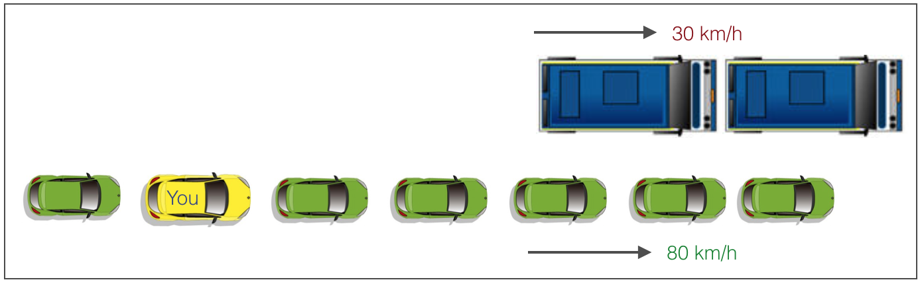
Decision Tree Pruning
There are 2 lanes:
A lane with cars moving at 80km/h
A lane with trucks moving at 30km/h
At this instant, you are the yellow car and you have 2 choices:
Take a left and overtake the other 2 cars quickly
Keep moving in the present lane

Slide 40
Decision Tree Pruning
Lets analyze these choice. In the former choice, you’ll immediately overtake the car ahead and reach behind the truck and start moving at 30 km/h, looking for an opportunity to move back right.
All cars originally behind you move ahead in the meanwhile.
This would be the optimum choice if your objective is to maximize the distance covered in next say 10 seconds.
In the later choice, you sale through at same speed, cross trucks and then overtake maybe depending on situation ahead.
This is exactly the difference between normal decision tree & pruning.
A decision tree with constraints won’t see the truck ahead and adopt a greedy approach by taking a left.
On the other hand if we use pruning, we in effect look at a few steps ahead and make a choice.

Slide 41
So we know pruning is better.
But how do we implement it in decision tree?
We first make the decision tree to a large depth.
Then we start at the bottom and start removing leaves which are giving us negative returns when compared from the top.
Suppose a split is giving us a gain of say -10 (loss of 10) and then the next split on that gives us a gain of 20. A simple decision tree will stop at step 1 but in pruning, we will see that the overall gain is +10 and keep both leaves.

Slide 42

Pruning Techniques
Reduced error pruning
One of the simplest forms of pruning is reduced error pruning.
Starting at the leaves, each node is replaced with its most popular class.
If the prediction accuracy is not affected then the change is kept.
While somewhat naive, reduced error pruning has the advantage of simplicity and speed.
Cost complexity pruning
Cost complexity pruning generates a series of trees $T_{0}. . . T_{m}$ where $T_{0}$ is the initial tree and $T_{m}$ is the root alone. At step i the tree is created by removing a subtree from tree $i−1$ and replacing it with a leaf node with value chosen as in the tree building algorithm.
The subtree that is removed is chosen as follows. Define the error rate of tree T over data set S as $err(T,S)$. The subtree that minimizes
$$\frac{err\left(prune\left(T,t\right),S\right)−err(T,s)}{\left|leaves(T)\right|−\left|leves(prune\left(T,t\right))\right|}$$
is chosen for removal. The function prune(T,t) defines the tree gotten by pruning the subtrees t from the tree T.
Once the series of trees has been created, the best tree is chosen by generalized accuracy as measured by a training set or cross-validation

Slide 43
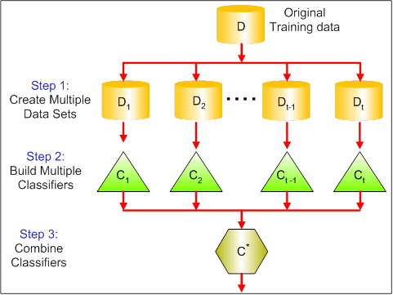
What is Bagging?
Bagging is a technique used to reduce the variance of our predictions by combining the result of multiple classifiers modeled on different sub-samples of the same data set.
The following figure will make it clearer:

Slide 44
Bagging Steps
Create Multiple DataSets:
Sampling is done with replacement on the original data and new datasets are formed.
The new data sets can have a fraction of the columns as well as rows, which are generally hyper-parameters in a bagging model
Taking row and column fractions less than 1 helps in making robust models, less prone to overfitting
Build Multiple Classifiers:
Classifiers are built on each data set.
Generally the same classifier is modeled on each data set and predictions are made.
Combine Classifiers:
The predictions of all the classifiers are combined using a mean, median or mode value depending on the problem at hand.
The combined values are generally more robust than a single model.
Note: Here the number of models built is not a hyper-parameters. Higher number of models are always better or may give similar performance than lower numbers. It can be theoretically shown that the variance of the combined predictions are reduced to 1/n (n: number of classifiers) of the original variance, under some assumptions.

Slide 45
Grow the Tree Recursive partitioning and regression trees (rpart)
To grow a tree, use rpart(formula, data=, method=,control=), where
formula | is in the format outcome ~ predictor1+predictor2+predictor3+ect.
data= | specifies the data frame
method= | "class" for a classification tree "anova" for a regression tree
control= | optional parameters for controlling tree growth. For example, control=rpart.control(minsplit=30, cp=0.001) requires that the minimum number of observations in a node be 30 before attempting a split and that a split must decrease the overall lack of fit by a factor of 0.001 (cost complexity factor) before being attempted.

Slide 46
Examine the results
printcp(fit) | display cp table
plotcp(fit) | plot cross-validation results
rsq.rpart(fit) | plot approximate R-squared and relative error for different splits (2 plots). labels are only appropriate for the "anova" method.
print(fit) | print results
summary(fit) | detailed results including surrogate splits
plot(fit) | plot decision tree
text(fit) | label the decision tree plot
post(fit,file=) | create postscript plot of decision tree

Slide 47
Kyphosis Dataset
Let’s use the data frame kyphosis to predict a type of deformation (kyphosis) after surgery, from age in months, number of vertebrae involved, and the highest vertebrae operated on.
In R, call the rpart library. Recursive partitioning for classification, regression and survival trees.
Kyphosis
a response factor with levels absent present.
Age
of child in months, a numeric vector
Number
of vertebra involved in the operation,a numeric vector
Start
level of the operation, a numeric vector

Slide 48
Decision Tree Learning using R
# Classification Tree with rpart
library(rpart)
# grow tree
fit <- rpart(Kyphosis ~ Age + Number + Start, method= "class", data=kyphosis)
# display the results
printcp(fit)
Classification tree:
rpart(formula = Kyphosis~Age + Number + Start, data = kyphosis,
method = “class”)
Variables actually used in tree construction:
[1] Age Start
Root node error: 17/81 = 0.20988
n= 81
CP nsplit rel error xerror xstd
1 0.176471 0 1.00000 1.0000 0.21559
2 0.019608 1 0.82353 1.2353 0.23200
3 0.010000 4 0.76471 1.2941 0.23548

Slide 49
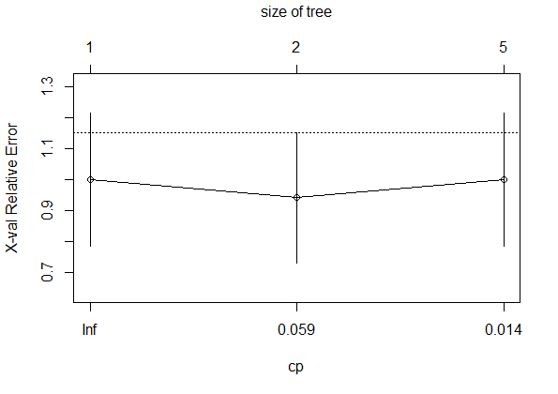
Decision Tree Learning using R
# visualize cross-validation results
plotcp(fit)

Slide 50
Decision Tree Learning using R
# detailed summary of splits
summary(fit)
Call:
rpart(formula = Kyphosis ~ Age + Number + Start, data = kyphosis,
method = “class”)
n= 81
CP nsplit rel error xerror xstd
1 0.17647059 0 1.0000000 1.000000 0.2155872
2 0.01960784 1 0.8235294 1.117647 0.2243268
3 0.01000000 4 0.7647059 1.117647 0.2243268
Variable importance
Start Age Number
64 24 12

Slide 51
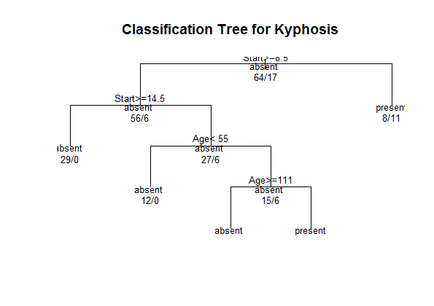
Decision Tree Learning using R
# plot tree
plot(fit, uniform=TRUE, main= "Classification Tree for Kyphosis")
text(fit, use.n=TRUE, all=TRUE, cex=.8)

Slide 52
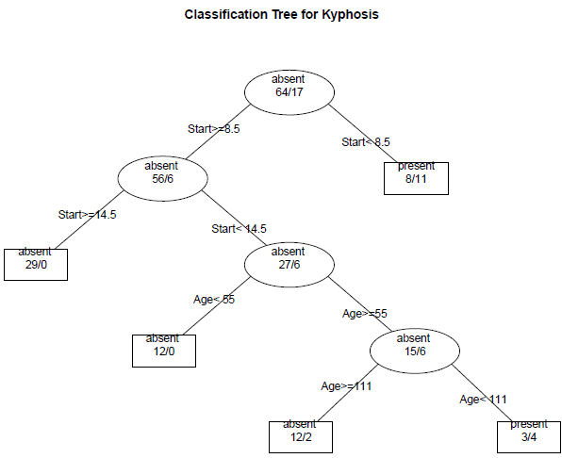
Create a Postscript Plot
# create attractive postscript plot of tree
post(fit, file = "c:/tree.ps", title = "Classification Tree for Kyphosis")
We Should be able to trim this to two branches

Slide 53
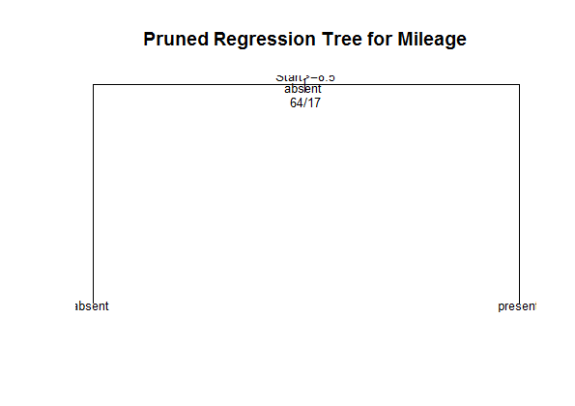
Prune and Plot the Pruned Tree
# prune the tree
pfit <- prune(fit,cp= fit$cptable [which.min(fit$cptable[,"xerror"]), "CP"])
# plot the pruned tree
plot(pfit, uniform=TRUE, main="Pruned Regression Tree for Mileage")
text(pfit, use.n=TRUE, all=TRUE, cex=.8)

Slide 54
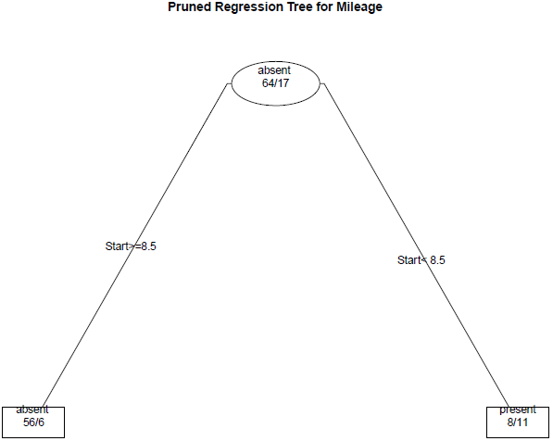
Create a Postscript Plot for Pruned Tree
post(pfit, file = "C:/Users/Strickland/Documents/VIT University/ptree2.ps", title = "Pruned Regression Tree for Mileage")

Slide 55
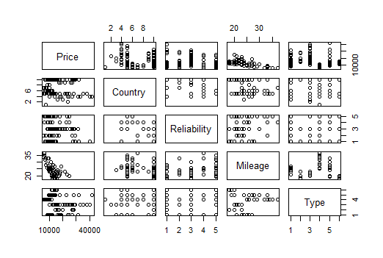
Regerssion Trees – Car Maker Data
The cu.summary data frame has 117 rows and 5 columns, giving data on makes of cars taken from the April, 1990 issue of Consumer Reports.
Price
a numeric vector giving the list price in US dollars of a standard model
Country
of origin, a factor with levels Brazil, England, France, Germany, Japan, Japan/USA, Korea, Mexico, Sweden and USA
Reliability
an ordered factor with levels Much worse < worse < average < better < Much better
Mileage
fuel consumption miles per US gallon, as tested.
Type
a factor with levels Compact Large Medium Small Sporty Van

Slide 56
Regression Tree
# Regression Tree Example
library(rpart)
# grow tree
fit <- rpart(Mileage~Price + Country + Reliability + Type, method=“anova”, data=cu.summary)
printcp(fit) # display the results
plotcp(fit) # visualize cross-validation results

Slide 57
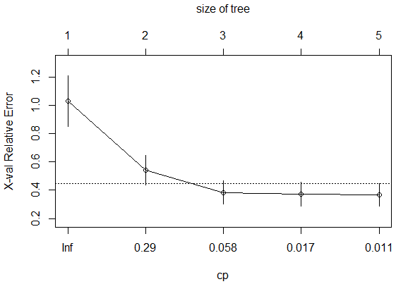
Regression Tree Example
# Regression Tree Example
library(rpart)
# grow tree
fit <- rpart(Mileage~Price + Country + Reliability + Type, method=“anova”, data=cu.summary)
printcp(fit) # display the results
plotcp(fit) # visualize cross-validation results

Slide 58
Regression Tree Summary
summary(fit) # detailed summary of splits
Call:
rpart(formula = Kyphosis ~ Age + Number + Start, data = kyphosis,
method = "class")
n= 81
CP nsplit rel error xerror xstd
1 0.17647059 0 1.0000000 1.0000000 0.2155872
2 0.01960784 1 0.8235294 0.9411765 0.2107780
3 0.01000000 4 0.7647059 1.0000000 0.2155872
Variable importance
Start Age Number
64 24 12

Slide 59
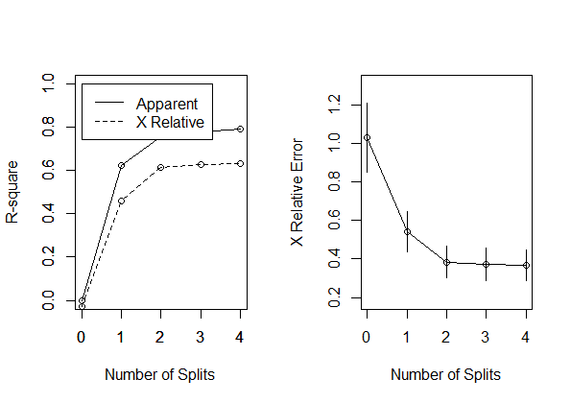
Additional Plots
# create additional plots two plots on one page
par(mfrow=c(1,2))
# visualize cross-validation results
rsq.rpart(fit)

Slide 60
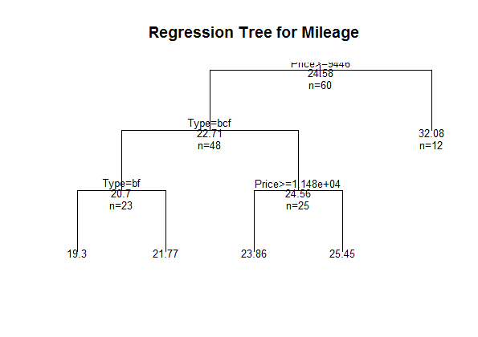
Regression Tree Plot – 3 Branches
# plot tree
plot(fit, uniform=TRUE, main= "Regression Tree for Mileage")
text(fit, use.n=TRUE, all=TRUE, cex=.8)

Slide 61
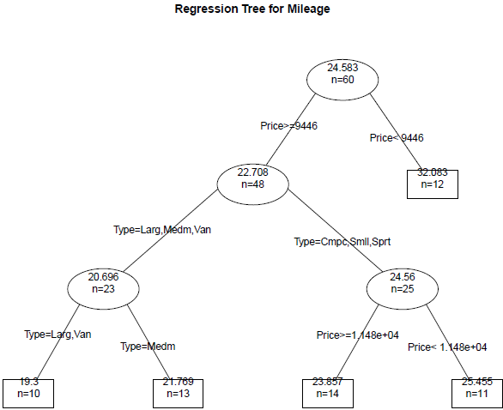
Create Postscript Plot of the Tree
post(fit, file = "C:/Users/Strickland/Documents/VIT University/ptree4.ps", title = "Regression Tree for Mileage")

Slide 62
Prune and Plot the Pruned Tree
# prune the tree
# from cptable
pfit2<- prune(fit2, cp=0.01160389)
# plot the pruned tree
plot(pfit2, uniform=TRUE, main= "Pruned Regression Tree for Mileage")
text(pfit2, use.n=TRUE, all=TRUE, cex=.8)
post(pfit2, file = "c:/ptree2.ps", title = "Pruned Regression Tree for Mileage")
No change in the plot

Slide 63
www.humalytica.com
http://www.amazon.com/Jeffrey-Strickland/e/B00IQ69QZK/
http://www.lulu.com/spotlight/strickland_jeffrey

